Slide 1

A Brief introduction to Tableau
Robert M Chapple

Slide 2


Who’s this dude?
Robert M Chapple

Slide 3
What this is
A very brief introduction to some key functionality of Tableau

Slide 4
What this is not
A Comprehensive Tableau Training Course

Slide 5
What this is not
A Comprehensive Tableau Training Course
Sorry!

Slide 6
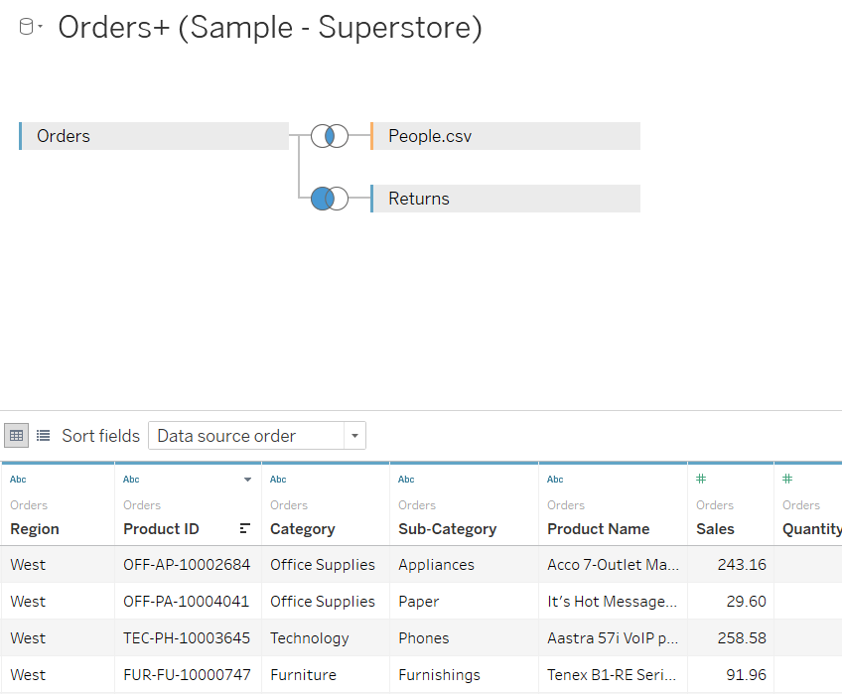
What we’re going to do today
Connect to Data

Slide 7
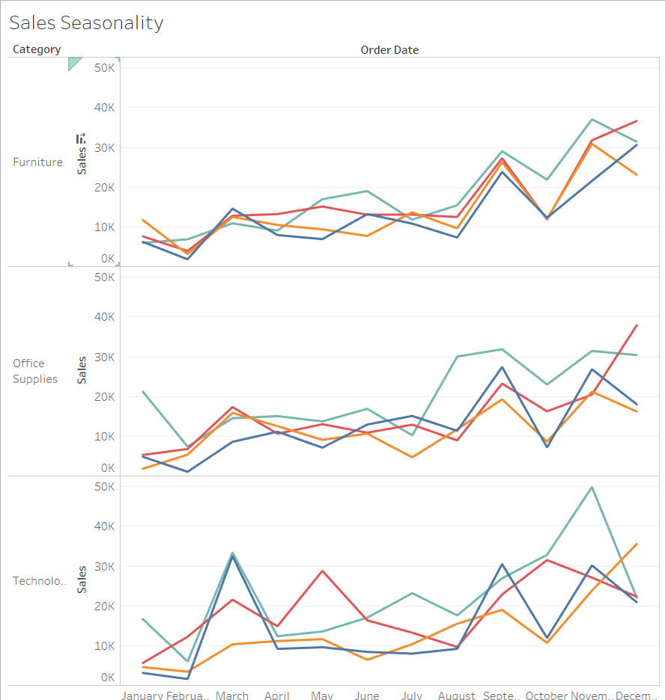
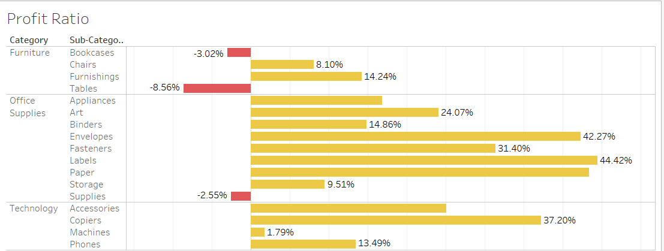
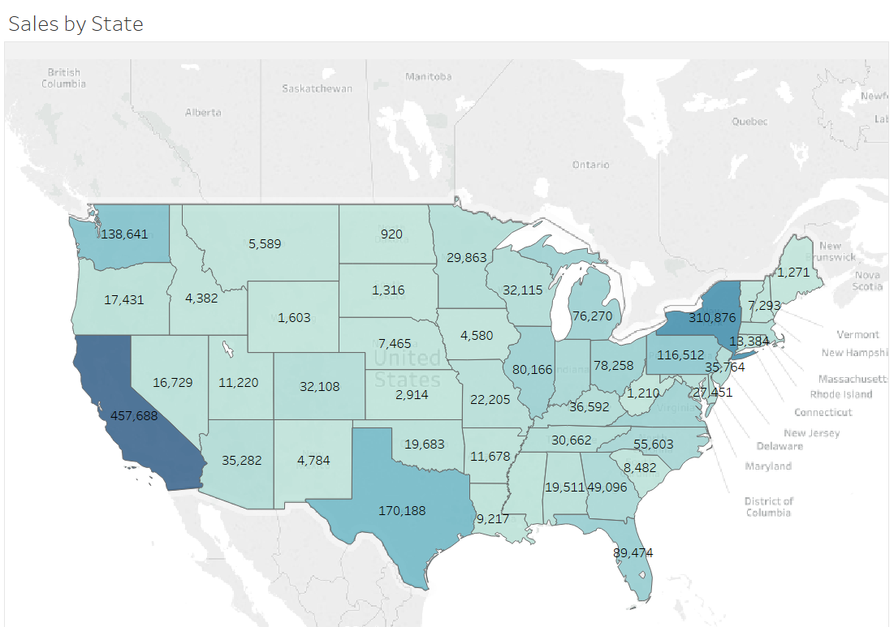
What we’re going to do today
Connect to Data
Create some Graphs

Slide 8
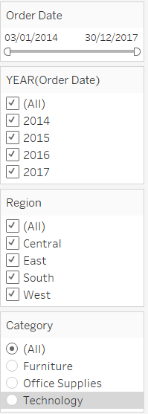
What we’re going to do today
Connect to Data
Create some Graphs
Create some Filters

Slide 9
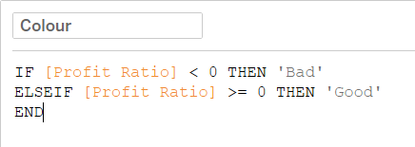
What we’re going to do today
Connect to Data
Create some Graphs
Create some Filters
Create some Calculated Fields

Slide 10
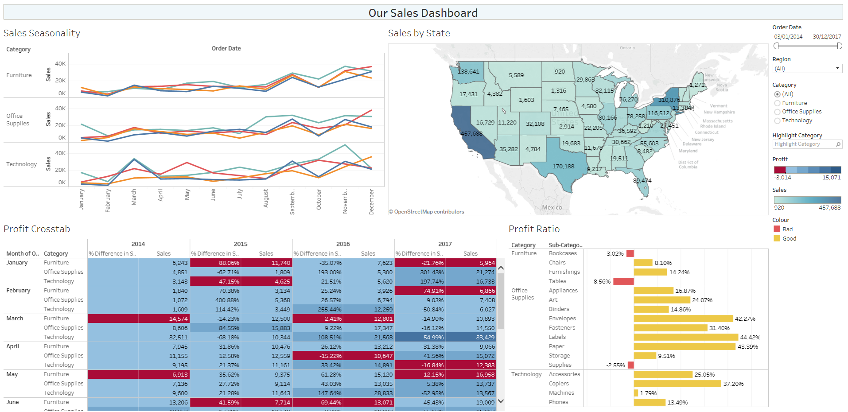
What we’re going to do today
Connect to Data
Create some Graphs
Create some Filters
Create some Calculated Fields
Create a Dashboard

Slide 11
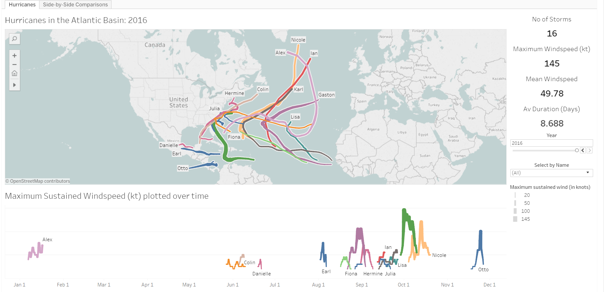
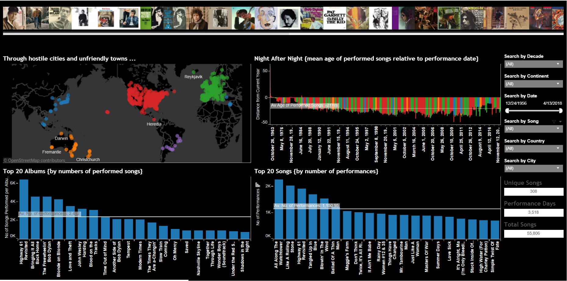
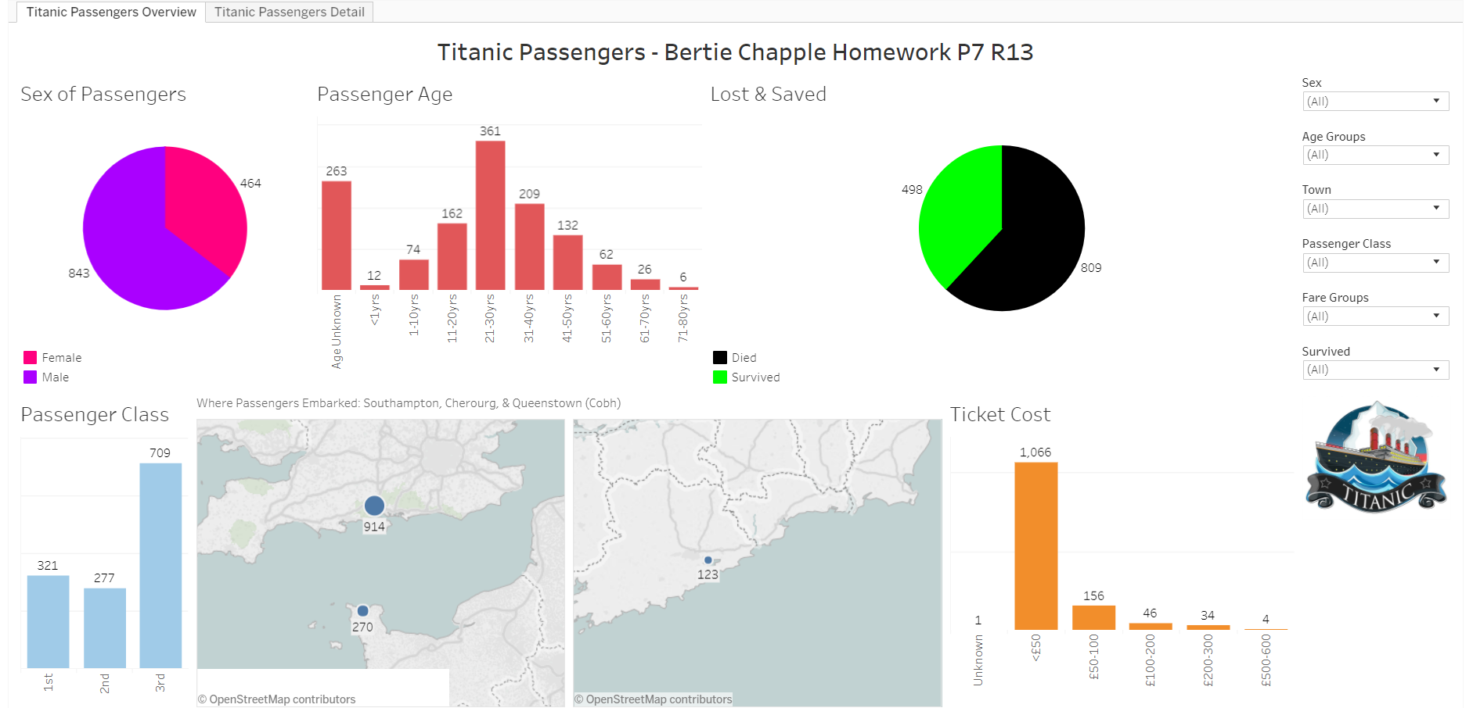
What we’re going to do today
Connect to Data
Create some Graphs
Create some Filters
Create some Calculated Fields
Create a Dashboard
Look at some examples of Tableau

Slide 12
Let’s go to the Demo!

Slide 13
Tableau examples
https://goo.gl/fAeWQC
Bob Dylan (Nobel Laureate)

Slide 14
Tableau examples
https://goo.gl/8q7UPY
Hurricanes in the Atlantic Basin 1851-2016

Slide 15
Tableau examples
https://goo.gl/HWz399
Titanic Passengers

Slide 16

Tableau examples
https://goo.gl/HWz399
by Bertie Chapple, age 11 (P7)
Titanic Passengers

Slide 17



Thank you for listening
Any questions?
My Tableau Public Page:
https://goo.gl/F3rQeP
demonCoreData:
https://goo.gl/KQp9qU
Resources on GitHub:
https://goo.gl/A98KMZ
YouTube:
https://goo.gl/9omwKi
rchh6@allstate.com

Slide 18

One Key takeaway

Slide 19

One Key takeaway

